Slide 1
Cloud Services and Queue
Microsoft Research
Microsoft Azure for Research Training

Slide 2
Agenda
Microsoft Azure Compute Options
What is a Cloud Service
Traditional Architecture Challenge
What is a Queue
Scalable Architecture with Queues
Notes:
Slide Objectives:
Introduce the topics that will be covered in this session
VALUE PROP
Speaking Points:
Notes:

Slide 3
Microsoft Azure Compute Options
Virtual Machines – most flexible
Web Sites – most convenient
HDInsight (Hadoop) – for big data
Mobile Services – for devices
Cloud Services – most scalable, most efficient
Notes:
Speaking Points:
Cloud Services – most scalable, highest uptime, multi-tier – with focus on business processing rather than infrastructure
Cloud Services enable a broader set of workloads then Microsoft Azure Web Sites, while providing more automated management then Microsoft Azure Virtual Machines.
The rest of this talk is about Cloud Services

Slide 4

Cloud services
Build highly scalable apps and services
Multi-tier, multi-instance architectures
Can be combined with other compute services
Stateless node, horizontal scaling approach
Automated application management
Notes:
Speaking Points:
Enables you to build what we sometimes refer to as infinitely scalable applications. They can support thousands of cores.
Support not only web based deployments, but also multi-tier architectures where you might have a combination of front ends, middle tiers, as well as virtual machines running as part of your solution.
Supports automated application management, so it is really easy to deploy, scale out, isolate, and recover from any type of hardware failure.
As well as support for automated updates.
Managed upgrades.

Slide 5
What is a Cloud Service?
A container of related service roles
Web Role
Worker Role
Notes:
Note: VM is separated out as IaaS offering.

Slide 6
A Cloud Service consists of …
Web Roles
1+ types
Windows Server
Running IIS
Service Model & Config
Deployment Package (includes compiled code)
VM Sizes (per role)
Role Instance (VM) Counts
Endpoints
Runtime Config Settings
Worker Roles
1+ types
Windows Server
Could run Tomcat, etc.
Notes:
Speaking Points:
Running Windows OS – so anything that runs on Windows could potentially run here – C++, Java, Python, etc.
Role Instance (VM) Counts are # of VM instances for each Role Type – but is just a starting point – you can scale (or autoscale) after this
Antenna looking thing is an END POINT

Slide 7
What Can It Run?
General Rule
If it runs in Windows it runs in Microsoft Azure
Choice of Language
C#, VB, C++, Java, PHP, Node.js, Phython, etc.
Choice of Frameworks
.NET, ExpressJS, Rails, Zend, etc.

Slide 8
Roles and Instances
Roles are defined in a Hosted Service
A role definition specifies:
VM size
Communication Endpoints
Local storage resources
etc.
At runtime each Role will execute on one or more instances
A role instance is a set of code, configuration, and local data, deployed in a dedicated VM
Notes:
Slide Objective
Understand the difference between Roles and Instances
Speaker Notes
The Service model defines the shape of a service-
the Roles it will have
endpoints it will listen on
Types of VMs that will be run
At runtime each Role will run at a given scale
Specifically each role will be deployed onto and executed on one or more VMs
A VM runs a single role
Notes
Notes on the various security roles involved in running a Microsoft Azure account
http://blog.toddysm.com/2010/01/subscription-and-service-administration-in-windows-azure.html

Slide 9
Roles and Instances Example Hosted Service configuration with a single web role and a single worker role
Hosted Service
Web Role
Worker Role
VM₁
VM₂
VM₃
VM₄
VM₁
VM₂
VM₃
VM₄
VM₅
VM₆
VM₇
VM₈
VM₅
VM_{n}
…
VM₉
VM_{n}
…

Slide 10
Fault Domains
99.95% Uptime Guarantee
Requires 2 or more instance per role
Role instance are isolated by fault domain
Fault domains isolate VMs
Fault domains provide redundancy
At least two fault domains per role
Notes:
The infrastructure of each Microsoft Azure data center is notionally divided into multiple sections known as fault domains. These sections of the infrastructure (which are not necessarily individual servers or server racks) are designed in such a way that a failure of one fault domain is extremely unlikely to affect any other fault domain. When you deploy a service, the Microsoft Azure Fabric Controller automatically locates the roles in at least two different fault domains so that a failure in one domain will not affect all instances of your service.

Slide 11
Upgrade Domains
Logical unit, which determines how particular service will be upgraded
Default number of upgrade domains that are configured for your application is 5 (five)
You can control how many upgrade domains your application will use through the

Slide 12
Roles and Instances Example role with nine virtual machines distributed across three fault domains
Network Load Balancer
Role
Fault Domain 1
Fault Domain 2
Fault Domain 3
VM₁
VM₃
VM₂
VM₄
VM₆
VM₉
VM₅
VM₈
VM₆
VM₉
Notes:
Slide Objective
Understand what a scale-out application looks like
Speaking notes
High scale applications often follow this sort of an pattern
Inbound connectivity comes through a load balancer
Requests are round robin routed
Load balancer is typically aware of the state of the web servers (i.e. are they up)
There are one or more tiers or groups of stateless web or app servers
By stateless we mean that they do not hold state between client requests
Stateless means that simple load balancing works – no need for sticky sessions
Stateless means that the failure of a web server does not cause major issues for application- it is simply removed from the load balancer
A stateful or storage tier
This will generally involve some sort of scale out approach for large apps
Often using partitioned databases
Often some sort of queuing mechanism
Applications will often perform processing in the background.
Improves response time for users
Allows load peaks to be buffered in queues
Microsoft Azure provides us with a Platform as a Service offering to implement these sorts of applications
Notes
http://msdn.microsoft.com/en-us/magazine/cc500561.aspx
http://msdn.microsoft.com/en-us/library/ff650667.aspx

Slide 13
Microsoft Azure SDKs and Tools
.Net
Visual Studio Tools
Client Libraries for .Net
Node.js
PowerShell Tools
Node.js for Windows
IISNode
Client Libraries for Node.js
Java
Eclipse Tools
Client Libraries for Java
php
Command Line Tools
Client Libraries for php

Slide 14

Microsoft Azure for .Net Developers
Microsoft Azure SDK for .Net
Windows Server 2008, Windows 7 or Windows 8
SQL Express 2005+
.NET 3.5 SP1+
Development Fabric
Development Storage
.NET APIs
Visual Studio 2012/2013
Project Templates
Model & Config Tooling
Package & 1 Click Deploy
Debugging Support
Storage Explorer
Server Explorer
IntelliTrace Support
Profiling Support
Notes:
Slide Objective
Introduce users to the tooling available to work with Microsoft Azure
Speaker Notes
Developer SDK is a Cloud in a box, allowing you to develop and debug locally without requiring a connection to the cloud. You can do this without Visual Studio as there are command line tools for executing the “cloud in a box” and publishing to the cloud.
There is also a separate download for the Visual Studio 2008 tools, which provide the VS debugging and templates. This in turn includes the SDK
Download the VS tools if you use VS. Download the raw SDK if you use alternative platforms (PHP etc…)
Requirements for Win 7 or Win 2008 are a dependency on IIS7 for the development fabric
Can install the bits with the Microsoft Web Platform Installer
Notes
Microsoft Azure Tools for Microsoft Visual Studio includes:
C# and VB Project creation support for creating a Microsoft Azure Cloud Service solution with multiple roles.
Tools to add and remove roles from the Cloud Service.
Tools to configure each Role.
Integrated local development via the Development Fabric and Development Storage services.
Running and Debugging a Cloud Service in the Development Fabric.
Browsing cloud storage through the Server Explorer
Building and packaging of Cloud Service Packages.
Deploying to the Microsoft Azure.
Monitoring the state of your services through the Server Explorer.
Debugging in the cloud by retrieving IntelliTrace logs through the Server Explorer.

Slide 15
Role Programming Model
Inherits RoleEntryPoint
OnStart() Method
Called by Fabric on startup, allows you to perform initialization tasks. Reports Busy status to load balancer until you return true.
Run() Method
Main logic is here – can do anything, typically infinite loop. Should never exit.
OnStop() Method
Called when role is to be shutdown, graceful exit.
30 Seconds to tidy up.
Notes:
Slide Objective
Understand the role programming model in overview
Speaker Notes
A role is similar to a windows service. It gets started once deployed, and will get stopped when required.
It could get stopped because
we are re-deploying you to a different server
You actioned the stop from the web-portal
It’s up to you to keep running and NEVER return from Start() unless you have been told to stop. Note: you do not need to handle the stop – you can simply “fail”
Notes
http://msdn.microsoft.com/en-us/library/ee848065.aspx
http://blogs.msdn.com/b/jnak/archive/2010/02/11/windows-azure-roleentrypoint-method-call-order.aspxes

Slide 16
Role Lifecycle
All roles may extend RoleEntryPoint
Roles report status via RoleEnvironment
Methods
Events
Status
Fabric Calls
OnStart
StatusCheck
Busy
Requests Routed
Run
StatusCheck
Ready
Role Lifetime
OnStop
StatusCheck
Busy
Stopping
Notes:
Slide Objective
Understand the lifecycle of a Microsoft Azure role
Understand the methods that can be overridden in RoleEntryPoint
Understand the events that are raised by role instances when their status is changing
Speaker Notes
Roles will typically extend RoleEntryPoint
The fabric calls RoleEntryPoint methods as it starts and stops a role
WaWorkerHost process is started.
Worker Role assembly is loaded and surfed for a class that derives from RoleEntryPoint. This class is instantiated.
RoleEntryPoint.OnStart() is called.
RoleEntryPoint.Run() is called.
If the RoleEntryPoint.Run() method exits, the RoleEntryPoint.OnStop() method is called .
WaWorkerHost process is stopped. The role will recycle and startup again.
As a role changes state it will raise the StatusCheck event.
A status of Busy will mean the load balancer will not route requests to the instance.
Note
http://blogs.msdn.com/b/jnak/archive/2010/02/11/windows-azure-roleentrypoint-method-call-order.aspx
http://msdn.microsoft.com/en-us/library/ee848065.aspx

Slide 17
Worker Role Patterns
Queue Polling Worker
Poll and Pop Messages within while(true) loop
E.g. Map/Reduce pattern, background image processing
Listening Worker Role
Create TcpListener or WCF Service Host
E.g. Run a .NET SMTP server or WCF Service
External Process Worker Role
OnStart or Run method executes Process.Start()
Startup Task installs or executes background/foreground process
Custom Role Entry Point (executable or .Net assembly)
E.g. Run a database server, web server, distributed cache
Notes:
Slide Objective
Understand the 3 common patterns of worker roles
Speaker Notes
Pattern 1 – Polling
Worker role polls a Queue
Pops message
Performs work
Polls queue again
Pattern 2
Worker listens for inbound TCP request Can implement with Raw TcpListeners or use WCF or use Hosted Web Core
Pattern 3
Run a 3rd party process When the role starts up or runs use a Process.Start() call to run a standard windows executable
E.g. Running a database server
Notes
http://blog.smarx.com/posts/build-your-own-web-role-running-hosted-web-core-in-windows-azure
http://blog.smarx.com/posts/making-songs-swing-with-windows-azure-python-and-the-echo-nest-api

Slide 18
Web Role
All features of a worker role + IIS 7, 7.5 or IIS 8.0*
ASP.NET 3.5 SP1, 4.0 or 4.5* – 64bit
Hosts
Webforms or MVC
FastCGI applications (e.g. PHP)
Multiple Websites
Http(s)
Web/Worker Hybrid
Can optionally implement RoleEntryPoint *with Windows Server 2012
Notes:
Slide Objective
Understand how a Web Role extends the standard worker role
Speaker Notes
A web role takes all the capabilities and semantics of a worker role and adds the IIS Hostable Web Core
Web Roles run ASP.NET websites- they do this by using the IIS hostage web core.
pretty much anything that will work in a standard IIS ASP.NET Web Site should work in Microsoft Azure. At MIX09, we additionally added support for IIS7’s FastCGI capability. As a note, any files that are part of a asp.net project on windows azure are READ ONLY! If you need to be able to change the contents of files:
User Blob Storage
If its configuration, use the service model files – which can be changed at runtime.
Inbound protocols are http(s) – outbound protocols are any TCP connection but NOT UDP.
Notes
http://msdn.microsoft.com/en-us/library/dd179341.aspx
http://blogs.msdn.com/b/carlosag/archive/2008/04/14/hostyourownwebserverusingiis7.aspx
http://blogs.iis.net/ksingla/archive/2007/12/20/ins-amp-outs-of-hostable-web-core.aspx

Slide 19
Configuration Values
Store arbitrary configuration string values
Define in model
Populate in configuration
RoleEnvironment
.GetConfigurationSettingValue()
Don’t use web.config for values you wish to change at runtime
App/Web.config is packaged with deployment change requires re-deploy
*.cscfg supports change tracking and notification to running role instances
Notes:
Slide Objective
Explain Microsoft Azure specific configuration mechanism
Contrast with web.config
Speaker Notes
The service configuration file specifies the number of role instances to deploy for each role in the service, the values of any configuration settings, and the thumbprints for any certificates associated with a role.
The service configuration file specifies the details of the service deployment, including the number of instances of each role to run, the values for configuration settings defined by the model, and the thumbprints of certificates associated with the service. For more information
Web.config is used today to store configuration for asp.net web sites. Most ASP.NET things still require this, e.g. tracing, security etc.
Web.config cannot be changed once deployed – it’s a static file.
Instead you should store configuration that will change in the ServiceConfiguration files, and use the RoleEnvironment.GetConfigurationSetting method to read the value. Settings in the ServiceConfiguration file can be changed at runtime without restarting the VM!
Will still be times when you just use web.config e.g. System.WebServer settings, adding HttpModules and HttpHandlers etc…
Notes
http://msdn.microsoft.com/en-us/library/ee758710.aspx
http://dunnry.com/blog/2009/04/16/WhyDoesWindowsAzureUseACscfgFile.aspx

Slide 20
Upgrading Your Application
VIP Swap:
Uses Staging and Production environments
Allows to quickly swap environments
Production: v1 ↓ Staging: v2, after swap then Production: v2 ↑ Staging: v1
In-Place Upgrade
Performs a rolling upgrade on live service
Entire service or a single role
Manual or Automatic across update domains
Cannot change Service Model

Slide 21
VIP Swap
Network Load Balancer
Role
Production
Staging
Production
Staging
Package
VM₁
VM₂
VM₁
VM₂
VM₃
VM₄
VM₃
VM₄

Slide 22
Microsoft Azure Diagnostics
Role Instance Starts
Diagnostic Monitor Starts
Monitor is configured
Imperatively at Start time
Remotely any time
Configuration is saved in Storage
Monitor buffers data locally
User can set a quota (FIFO)
User initiates transfer to storage from local buffer
Scheduled
On Demand
Role Instance
Role
Diagnostic
Monitors
Local directory storage

Slide 23
Diagnostic Data Locations
WAD-Control-Container
Contains XML Configuration for each Role Instance in the Service
Diagnostic Data | Location in Storage
Windows Event Logs | WADWindowsEventLogsTable
Performance Counters (including custom performance counters) | WADPerformanceCountersTable
Microsoft Azure Logs | WADLogsTable
Diagnostic Infrastructure Logs | WADDiagnosticInfrastructureLogsTable
IIS Logs | wad-iis-logfiles - WADDirectoriesTable (index entry)
IIS Failed Request Logs | wad-iis-failedreqlogfiles - WADDirectoriesTable (index entry)
Crash Dumps | wad-crash-dumps - WADDirectoriesTable (index entry)
Custom File Based Logs | (must be configured) - WADDirectoriesTable (index entry)

Slide 24
Cloud Services
Load Balancer
Web Role
Instances
Worker Role
Instances
Notes:
Speaking Points:
Direct access to Worker Role Instances is a scalability bottleneck and is less useful than the pattern we are about to show
(Scalability of Web Tier (Web Role Instances) becomes bound to (and limited by) the scalability and reliability of the Service Tier (Worker Role Instances))
There’s a better way

Slide 25
The High Scale Application Archetype Microsoft Azure provides a ‘pay-as-you-go’ scale out application platform
Intelligent Network Load Balancer
Network Activation
Stateless Web and/or Application Servers
Stateless ‘Worker’ Machines
Async Activation
State Tier
Queues
Key/Value Datastores
Partitioned RDBMS
Shared Filesystem
Notes:
Slide Objective
Understand what a scale-out application looks like
Speaking notes
High scale applications often follow this sort of an pattern
Inbound connectivity comes through a load balancer
Requests are round robin routed
Load balancer is typically aware of the state of the web servers (i.e. are they up)
There are one or more tiers or groups of stateless web or app servers
By stateless we mean that they do not hold state between client requests
Stateless means that simple load balancing works – no need for sticky sessions
Stateless means that the failure of a web server does not cause major issues for application- it is simply removed from the load balancer
A stateful or storage tier
This will generally involve some sort of scale out approach for large apps
Often using partitioned databases
Often some sort of queuing mechanism
Applications will often perform processing in the background.
Improves response time for users
Allows load peaks to be buffered in queues
Microsoft Azure provides us with a Platform as a Service offering to implement these sorts of applications
Notes
http://msdn.microsoft.com/en-us/magazine/cc500561.aspx
http://msdn.microsoft.com/en-us/library/ff650667.aspx

Slide 26
Service Bus Queue
Durable queue – won’t lose your data
Reliable – backed by SLA and operations team
Scalable – built for Internet scale
Feature rich – supports “at least once” and “at most once” delivery guarantees, pinning, suspend, & more…
Enables Load Leveling
Similar to the Microsoft Azure Storage Queue
Notes:
Speaking Points:
Adding this tool to our arsenal…
Load Leveling is idea that since Service Tier (Worker Role Instances) work is pulled, it and the Web Tier can operate independently (the Service Tier can “fall behind” and then catch up later when the Web Tier volume decreases)
May need to think about Idempotency & Poison Messages

Slide 27
Scalable Architecture
Web Role Instances
Queue
Worker Role
Instances
Notes:
Speaking Points:
Queue-Centric Workflow Pattern
Idempotency

Slide 28
Earthquake on Cloud Service
demo

Slide 29
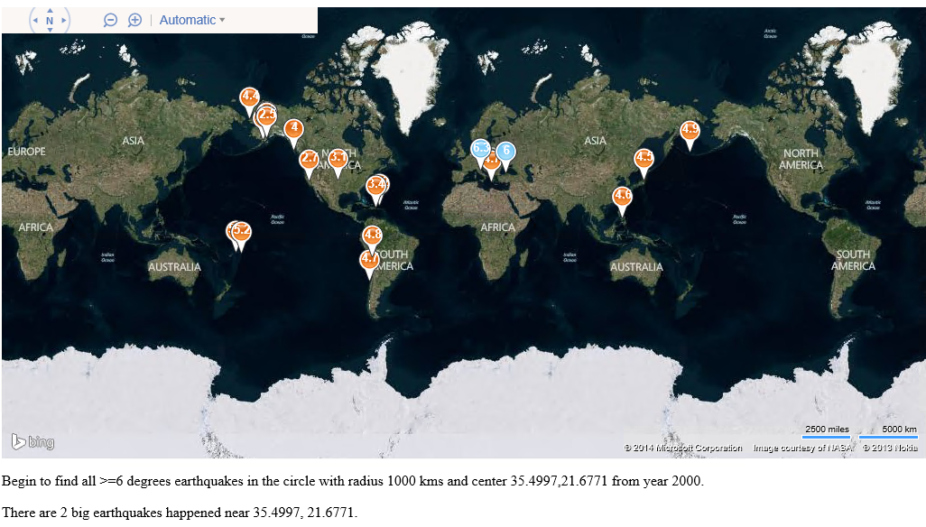

Slide 30
Demo: A generic implementation of a Scalable Simulation Runner
Open source, Supports R, Matlab, Python, exe, and more

Slide 31
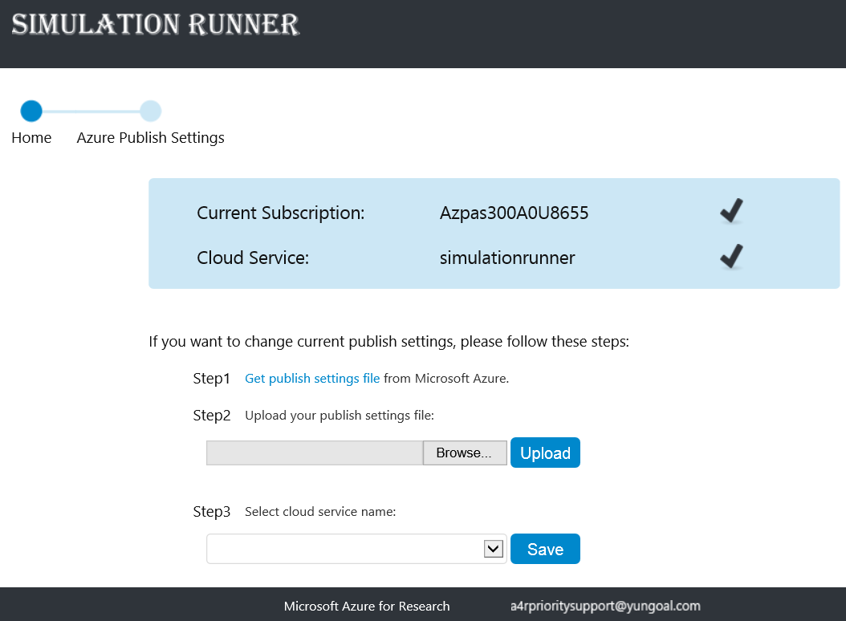

Slide 32
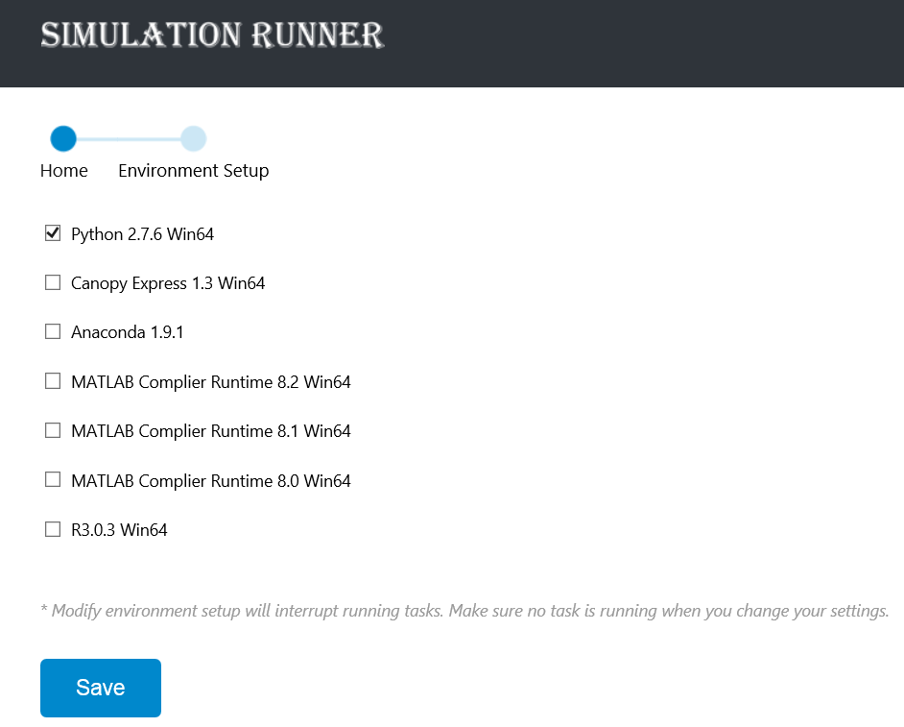

Slide 33
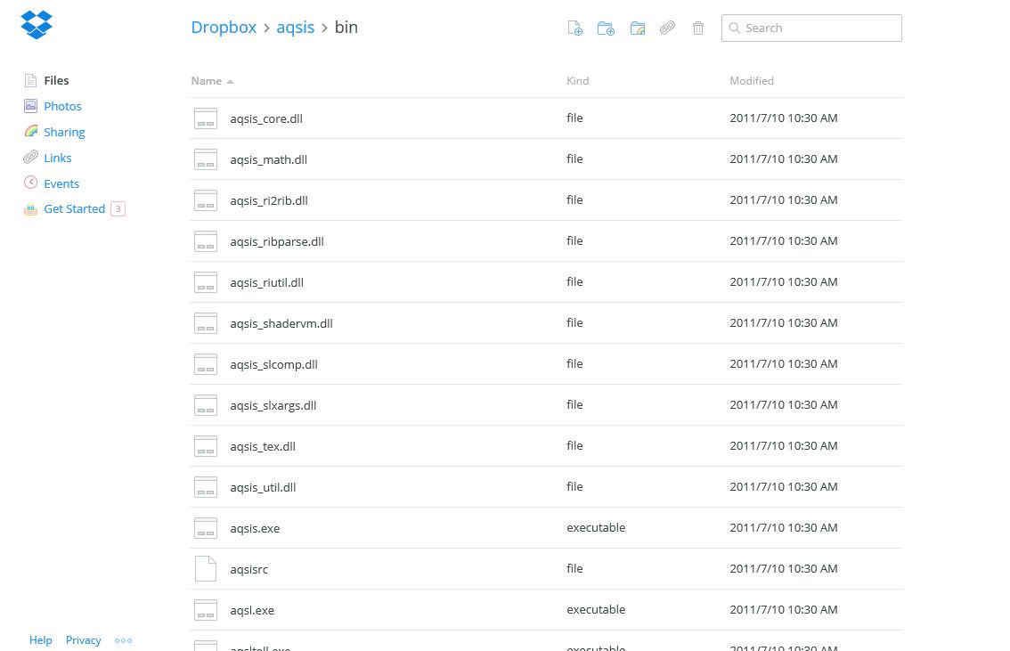
Notes:
Dropbox support, drag your exe python R scripts here.

Slide 34
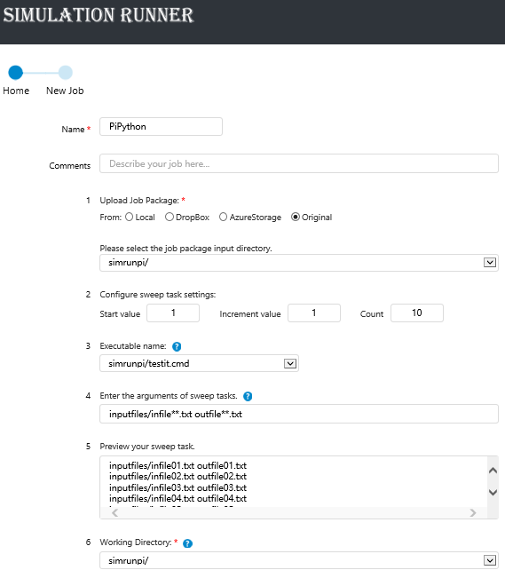
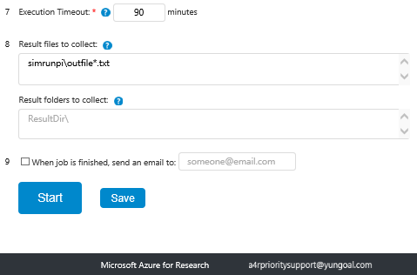

Slide 35
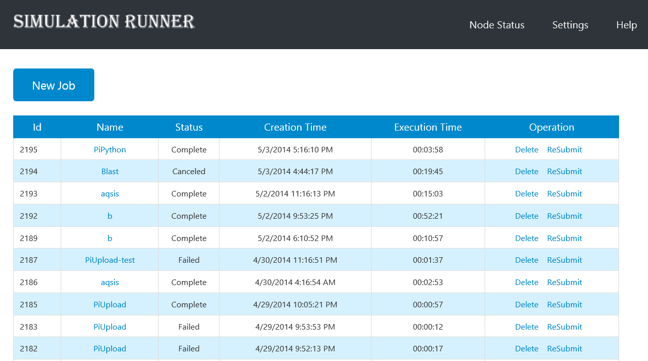

Slide 36
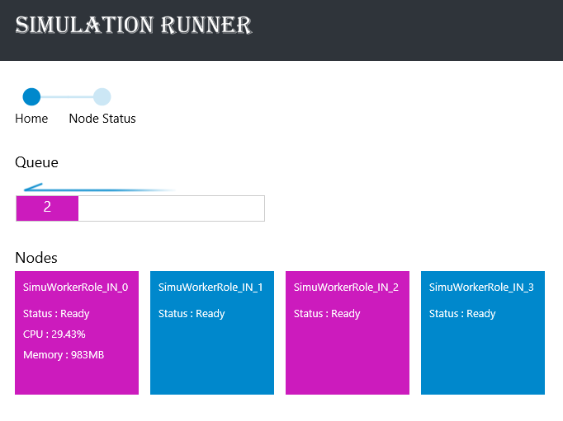
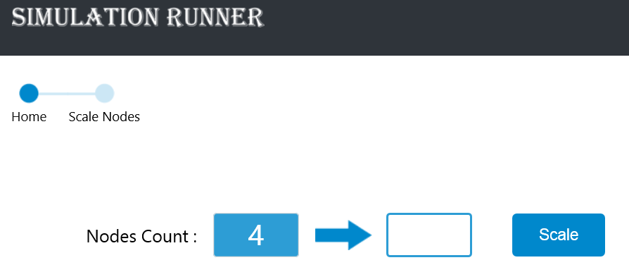

Slide 37
Cloud Services and Queue
Learning objectives – what you learned:
Understanding of Cloud Services, Web Roles, and Worker Roles
Understanding of Queues
How to Combine Cloud Services and Queues for highly scalable architecture

